Slide 1
General Principles for the Safe Performance, Training, and Adoption of Ablation Techniques for Benign Thyroid nodules: An ATA® Statement
Pre-Procedure Management

Slide 2
Patient Eligibility & Selection
Compressive and/or cosmetic complaints due to a single nodule
Solitary autonomously functioning nodules
Ensure nodule is benign prior to treatment:
TIRADS 1 or 2 = single benign biopsy
TIRADS 3 or 4 = two benign biopsies
Autonomously functioning nodule = single benign biopsy

Slide 3
Patient Eligibility & Selection
Non-functioning nodules:
Minimum 2 – 3 cm
No maximum size
Volume >20 – 30 ml are more likely to need multiple treatments
Autonomous nodules:
Confirm hyperfunctioning nodule with RAIUS
Volume <10 – 12 ml optimal to achieve euthyroidism

Slide 4
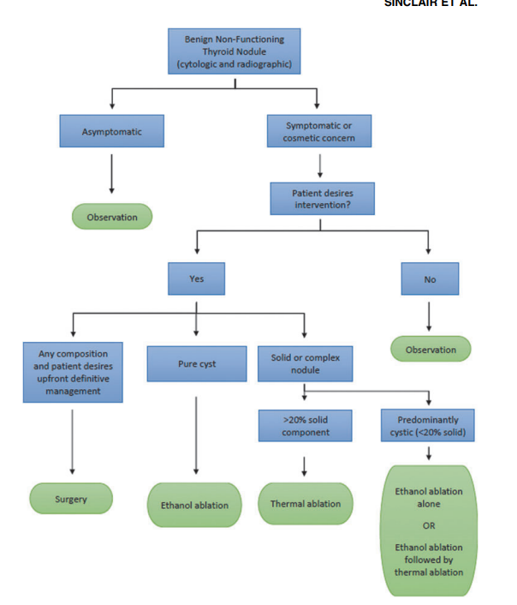
Considerations of technique
Solid nodules are candidates for thermal ablation
Purely cystic nodules, or those >20% cystic are best treated with ethanol ablation

Slide 5
Relative contraindications
TIRADS 5 nodule
Indeterminate biopsy results with negative molecular markers
Multinodular goiter with bilateral nodularity
Significant substernal extension
Pregnancy
Pacemaker or ICD
Unable to discontinue anticoagulants prior to procedure

Slide 6
Absolute contraindications
Cytologically indeterminate biopsy result with positive molecular testing
Known malignancy >1.5 cm
Treatment areas not able to be visualized on ultrasound

Slide 7
Patient Counseling
Set realistic expectations
Present alternative management options without bias
Review risks and benefits (see following slides)
Review need to discontinue anticoagulation:
Anticoagulant | Discontinue | Resume
Warfarin | 5 days prior | Day following procedure
Anti-platelet agents | 7-10 days prior | Day following procedure
Direct oral anticoagulants | 24 – 36 hours prior | Day following procedure

Slide 8
Benefits of Ablative Techniques
Reduction in nodule volume
Improvement in compressive symptoms and cosmetic concerns
Avoidance of scars and thyroid hormone supplementation
Outpatient procedure
Less recovery time compared to surgery

Slide 9
Risks of Ablative Techniques
Thermal/chemical injury to the recurrent laryngeal nerve
Nodule rupture
Bleeding/hematoma
Failure to correct hyperthyroidism (for autonomous nodules)
Possible need for repeat procedures (for large nodules)
Delayed diagnosis of missed malignancies

